Slide 1
Module 3 EXPERIMENTAL DESIGNS
Topic – Brief introduction to completely randomized design,
randomized block design and Latin square designs

Slide 2
Basic principles of experimental designs
The basic principles of experimental designs are
(1) Principle of Replication
(2) Principle of Randomization
(3) Principle of Local Control.

Slide 3
Principle of Replication
According to the Principle of Replication, the experiment should be repeated more than once.
Each treatment is applied in many experimental units instead of one.
By doing so the statistical accuracy of the experiments is increased.
For example, suppose we are to examine the effect of two varieties of rice. For this purpose we may divide the field into two parts and grow one variety in one part and the other variety in the other part.
We can then compare the yield of the two parts and draw conclusion on that basis.
But if we are to apply the principle of replication to this experiment, then we first divide the field into several parts, grow one variety in half of these parts and the other variety in the remaining parts.
We can then collect the data of yield of the two varieties and draw conclusion by comparing the same.
The result so obtained will be more reliable in comparison to the conclusion we draw without applying the principle of replication. The entire experiment can even be repeated several times for better results
Replication is introduced in order to increase the precision of a study; that is to say, to increase the accuracy with which the main effects and interactions can be estimated.

Slide 4
Principle of Randomization
When we conduct an experiment the principle of Randomization provides protection against the effect of extraneous factors using randomization.
For instance, if we grow one variety of rice, say, in the first half of the parts of a field and the other variety is grown in the other half, then it is just possible that the soil fertility may be different in the first half in comparison to the other half.
If this is so, our results would not be realistic.
In such a situation, we may assign the variety of rice to be grown in different parts of the field on the basis of some random sampling technique i.e., we may apply randomization principle and protect ourselves against the effects of the extraneous factors (soil fertility differences in the given case).
As such, through the application of the principle of randomization, we can have a better estimate of the experimental error.

Slide 5
Principle of Local Control
It has been observed that all extraneous sources of variation are not removed by randomization and replication.
This necessitates a refinement of the experimental technique.
In other words, we need to choose a design in such a manner that all extraneous sources of variation are brought under control.
For this purpose, we make use of local control, a term referring to the amount of balancing, blocking and grouping of the experimental units.
Balancing means that the treatments should be assigned to the experimental units in such a way that the result is a balanced arrangement of the treatments.
Blocking means that like experimental units should be collected together to form a relatively homogeneous group.
The main purpose of the principle of local control is to increase the efficiency of an experimental design by decreasing the experimental error.

Slide 6
Under it the extraneous factor, the known source of variability, is made to vary deliberately in such a way that the variability it causes can be measured and hence eliminated from the experimental error.
This means that we should plan the experiment in a manner that we can perform a two-way analysis of variance, in which the total variability of the data is divided into three components attributed to treatments (varieties of rice in our case), the extraneous factor (soil fertility in our case) and experimental error.
According to the principle of local control, we first divide the field into several homogeneous parts, known as blocks, and then each such block is divided into parts equal to the number of treatments.
Then the treatments are randomly assigned to these parts of a block.
Dividing the field into several homogenous parts is known as ‘blocking’.
In general, blocks are the levels at which we hold an extraneous factor fixed, so that we can measure its contribution to the total variability of the data by means of a two-way analysis of variance.
In brief, through the principle of local control we can eliminate the variability due to extraneous factor(s) from the experimental error.

Slide 11
Important Experimental Designs
Experimental design refers to the framework or structure of an experiment.
We can classify experimental designs into two broad categories, viz., informal experimental designs and formal experimental designs.
Informal experimental designs are those designs that normally use a less sophisticated form of analysis based on differences in magnitudes, whereas formal experimental designs offer relatively more control and use precise statistical procedures for analysis.
Important experiment designs are as follows:
Informal experimental designs:
Before-and-after without control design.
After-only with control design.
Before-and-after with control design.
Formal experimental designs:
Completely randomized design (C.R. Design).
Randomized block design (R.B. Design).
Latin square design (L.S. Design).
Factorial designs.

Slide 12
Informal experimental designs:
Before-and-after without control design.
After-only with control design.
Before-and-after with control design.

Slide 13

Before-and-after without control design:
In such a design a single test group or area is selected and the dependent variable is measured before the introduction of the treatment. The treatment is then introduced and the dependent variable is measured again after the treatment has been introduced. The effect of the treatment would be equal to the level of the phenomenon after the treatment minus the level of the phenomenon before the treatment. The design can be represented thus:
The main difficulty of such a design is that with the passage of time considerable extraneous variations may be there in its treatment effect.

Slide 14

After-only with control design:
In this design two groups or areas (test area and control area) are selected and the treatment is introduced into the test area only. The dependent variable is then measured in both the areas at the same time. Treatment impact is assessed by subtracting the value of the dependent variable in the control area from its value in the test area. This can be exhibited in the following form:
The basic assumption in such a design is that the two areas are identical with respect to their behaviour towards the phenomenon considered. If this assumption is not true, there is the possibility of extraneous variation entering into the treatment effect. However, data can be collected in such a design without the introduction of problems with the passage of time. In this respect the design is superior to before-and-after without control design.

Slide 15
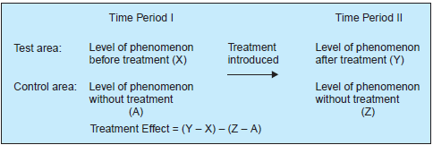
Before-and-after with control design:
In this design two areas are selected and the dependent variable is measured in both the areas for an identical time-period before the treatment. The treatment is then introduced into the test area only, and the dependent variable is measured in both for an identical time-period after the introduction of the treatment. The treatment effect is determined by subtracting the change in the dependent variable in the control area from the change in the dependent variable in test area. This design can be shown in this way:
This design is superior to the above two designs for the simple reason that it avoids extraneous variation resulting both from the passage of time and from non-comparability of the test and control areas. But at times, due to lack of historical data, time or a comparable control area, we should prefer to select one of the first two informal designs stated above.

Slide 16
Formal experimental designs
Completely randomized design (C.R. Design).
Randomized block design (R.B. Design).
Latin square design (L.S. Design).
Factorial designs.

Slide 17
Completely randomized design (C.R. Design).
Involves only two principles viz., the principle of replication and the principle of randomization of experimental designs.
It is the simplest possible design and its procedure of analysis is also easier. The essential characteristic of the design is that subjects are randomly assigned to experimental treatments.
For instance, if we have 10 subjects and if we wish to test 5 under treatment A and 5 under treatment B, the randomization process gives every possible group of 5 subjects selected from a set of 10 an equal opportunity of being assigned to treatment A and treatment B.
One-way analysis of variance (or one-way ANOVA) is used to analyse such a design.
It provides maximum number of degrees of freedom to the error. Such a design is generally used when experimental areas happen to be homogeneous.

Slide 18
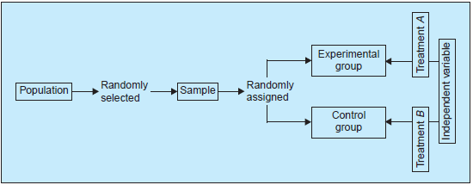
We can present a brief description of the two forms of such a design as given in figure.
Two-group simple randomized design: In a two-group simple randomized design, first of all the population is defined and then from the population a sample is selected randomly.
After being selected randomly from the population, be randomly assigned to the experimental and control groups (Such random assignment of items to two groups is technically described as principle of randomization).
Thus, this design yields two groups as representatives of the population.
Two-group simple randomized experimental design (in diagram form)

Slide 19
The two groups (experimental and control groups) of such a design are given different treatments of the independent variable.
This design of experiment is quite common in research studies concerning behavioural sciences.
The merit of such a design is that it is simple and randomizes the differences among the sample items.
But the limitation of it is that the individual differences among those conducting the treatments are not eliminated, i.e., it does not control the extraneous variable and as such the result of the experiment may not depict a correct picture.
This can be illustrated by taking an example. Suppose the researcher wants to compare two groups of students who have been randomly selected and randomly assigned.
Two different treatments viz., the usual training and the specialized training are being given to the two groups.
The researcher hypothesises greater gains for the group receiving specialised training.
To determine this, he tests each group before and after the training, and then compares the amount of gain for the two groups to accept or reject his hypothesis.
This is an illustration of the two-groups randomized design, wherein individual differences among students are being randomized.
But this does not control the differential effects of the extraneous independent variables (in this case, the individual differences among those conducting the training programme).

Slide 20
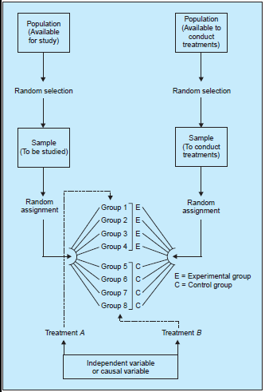
Random replications design: The limitation of the two-group randomized design is usually eliminated within the random replications design.
In a random replications design, the effect of extraneous independent variable are minimised by providing a number of repetitions for each treatment.
Each repetition is technically called a ‘replication’.
Random replication design serves two purposes viz., it provides controls for the differential effects of the extraneous independent variables and secondly, it randomizes any individual differences among those conducting the treatments.
From the diagram it is clear that there are two populations in the replication design.
The sample is taken randomly from the population available for study and is randomly assigned to, say, four experimental and four control groups.
Similarly, sample is taken randomly from the population available to conduct experiments and the eight individuals so selected should be randomly assigned to the eight groups.
Generally, equal number of items are put in each group so that the size of the group is not likely to affect the result of the study.
Thus, this random replication design is, in fact, an extension of the two-group simple randomized design.
Random replication design
(in diagram form)

Slide 22
Randomized block design (R.B. design)
It is an improvement over the C.R. design.
In the R.B. design the principle of local control can be applied along with the other two principles of experimental designs.
In the R.B. design, subjects are first divided into groups, known as blocks, such that within each group the subjects are relatively homogeneous in respect to some selected variable.
The variable selected for grouping the subjects is one that is believed to be related to the measures to be obtained in respect of the dependent variable.
The number of subjects in a given block would be equal to the number of treatments and one subject in each block would be randomly assigned to each treatment.
In general, blocks are the levels at which we hold the extraneous factor fixed, so that its contribution to the total variability of data can be measured.
The main feature of the R.B. design is that in this each treatment appears the same number of times in each block.
The R.B. design is analysed by the two-way analysis of variance (two-way ANOVA) technique.

Slide 23
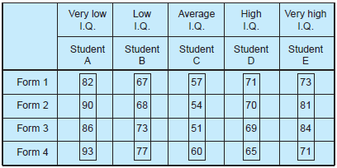
Let us illustrate the R.B. design with the help of an example. Suppose four different forms of a standardised test in statistics were given to each of five students (selected one from each of the five I.Q. blocks) and following are the scores which they obtained.
If each student separately randomized the order in which he or she took the four tests, we refer to the design of this experiment as a R.B. design.
The purpose of this randomization is to take care of such possible extraneous factors (say as fatigue) or perhaps the experience gained from repeatedly taking the test.

Slide 24
Latin square design (L.S. design)
It is an experimental design very frequently used in agricultural research.
The conditions under which agricultural investigations are carried out are different from those in other studies for nature plays an important role in agriculture.
For instance, an experiment has to be made through which the effects of five different varieties of fertilizers on the yield of a certain crop, say wheat, it to be judged.
In such a case the varying fertility of the soil in different blocks in which the experiment has to be performed must be taken into consideration; otherwise the results obtained may not be very dependable because the output happens to be the effect not only of fertilizers, but it may also be the effect of fertility of soil.
Similarly, there may be impact of varying seeds on the yield.
To overcome such difficulties, the L.S. design is used when there are two major extraneous factors such as the varying soil fertility and varying seeds.

Slide 25
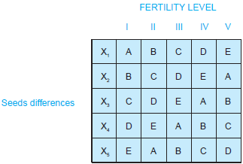
The Latin-square design is one wherein each fertilizer, in our example, appears five times but is used only once in each row and in each column of the design.
In other words, the treatments in a L.S. design are so allocated among the plots that no treatment occurs more than once in any one row or any one column.
The two blocking factors may be represented through rows and columns (one through rows and the other through columns).
The following is a diagrammatic form of such a design in respect of, say, five types of fertilizers, viz., A, B, C, D and E and the two blocking factor viz., the varying soil fertility and the varying seeds:
The above diagram clearly shows that in a L.S. design the field is divided into as many blocks as there are varieties of fertilizers and then each block is again divided into as many parts as there are varieties of fertilizers in such a way that each of the fertilizer variety is used in each of the block (whether column-wise or row-wise) only once.

Slide 26
The analysis of the L.S. design is very similar to the two-way ANOVA technique.
The merit of this experimental design is that it enables differences in fertility gradients in the field to be eliminated in comparison to the effects of different varieties of fertilizers on the yield of the crop.
But in L.S. design we must assume that there is no interaction between treatments and blocking factors.
Another limitation of this design is that it requires number of rows, columns and treatments to be equal. This reduces the utility of this design.
If treatments are 10 or more, than each row and each column will be larger in size so that rows and columns may not be homogeneous. This may make the application of the principle of local control ineffective.
Therefore, L.S. design of orders (5 × 5) to (9 × 9) are generally used.

